Slide 1


Introduction to Phishing Awareness
Phishing is a common online scam that uses deceptive tactics to trick victims into revealing sensitive information. This presentation will guide you through the essentials of phishing awareness, equipping you with the knowledge to protect yourself from these threats.

Slide 2

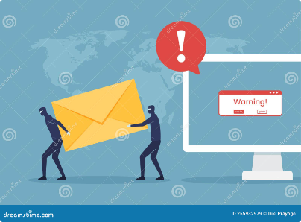
What is Phishing?
Deception
Impersonation
Data Theft
Phishing is a type of social engineering that uses deceptive techniques to trick victims into divulging personal information.
Phishing attacks often impersonate legitimate organizations or individuals to gain trust and exploit vulnerabilities.
The goal of phishing is to steal sensitive data, such as login credentials, financial information, and personal details.

Slide 3


Common Phishing Tactics
1
Fake Emails
2
Spoofed Websites
Phishing emails often mimic legitimate messages from trusted sources, such as banks, social media platforms, or online retailers.
Phishers create fake websites that look identical to legitimate ones, hoping to lure victims into entering their credentials.
3
Social Media Scams
4
SMS Phishing
Phishing attempts can also occur through social media platforms, with attackers using fake profiles to spread malicious links and messages.
Text messages can be used to deliver phishing links, urging recipients to click and provide sensitive information.

Slide 4


Identifying Phishing Attempts
1
Suspicious Sender
Pay attention to the email address or sender name. Check for typos, unusual domain names, or unfamiliar addresses.
2
Urgent Tone
Phishing emails often use a sense of urgency to pressure victims into quick action, for example, threatening to close an account or requiring immediate payment.
3
Suspicious Links
Hover over links to see the actual URL. If it doesn't match the expected website, it might be a phishing attempt.
4
Grammar and Spelling Errors
Phishing emails may contain grammatical or spelling mistakes, a red flag indicating a lack of authenticity.

Slide 5
Phishing Email Red Flags
Generic Greetings
Unprofessional Design
Requests for Personal Information
Phishing emails often use generic greetings like "Dear User" or "Dear Customer."
Phishing emails often have a poorly designed layout, inconsistent fonts, or unprofessional visuals.
Be cautious of emails that ask for sensitive information, such as your password, credit card details, or social security number.

Slide 6


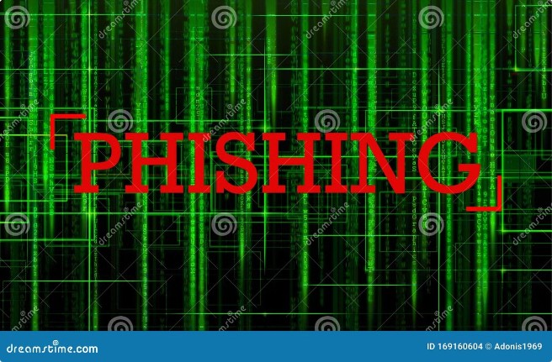



Phishing Website Red Flags
Unsecured Connection
Check for the "https" protocol and a padlock icon in the address bar. These indicate a secure connection.
Unusual Domain Names
Be wary of websites with unusual or misspelled domain names, as they could be phishing attempts.
Suspicious Content
Look for poor grammar, spelling errors, or unusual visuals, which might indicate a fake website.
Request for Sensitive Information
Never provide sensitive information on a website that you suspect might be fraudulent.

Slide 7

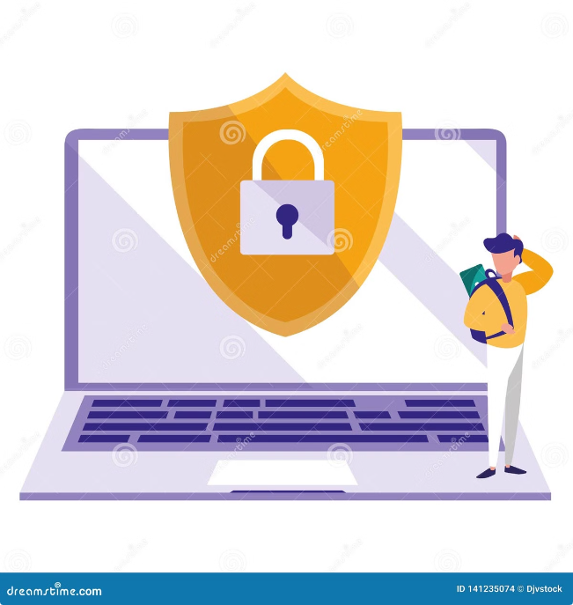




Protecting Yourself from Phishing
Strong Passwords
Be Vigilant
Use strong, unique passwords for all your online accounts and avoid reusing passwords across multiple sites.
Be cautious of unsolicited emails, suspicious links, and any requests for sensitive information.
Use Anti-Phishing Software
Report Phishing Attempts
Install and keep updated anti-phishing software on your devices to detect and block malicious websites and emails.
Report suspected phishing attempts to the relevant authorities and organizations.

Slide 8

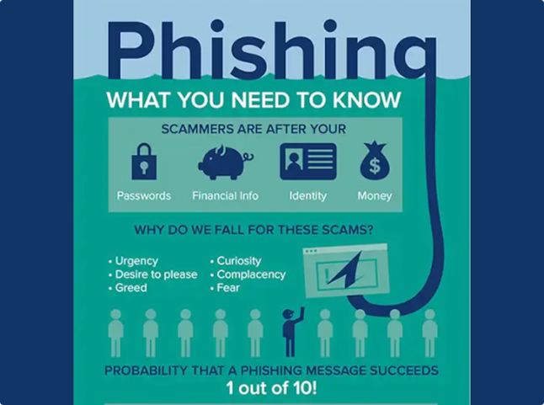
Reporting Phishing Attempts
Phishing Emails
Report to the email provider, the company or organization impersonated, and anti-phishing agencies.
Suspicious Websites
Report to website security companies, authorities, and the website hosting provider.
Social Media Scams
Report to the social media platform, block the scammer, and report the account to authorities.

Slide 9
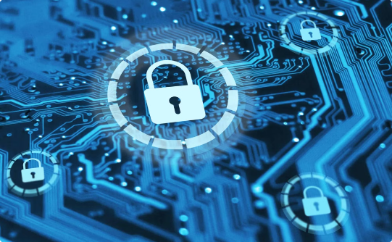

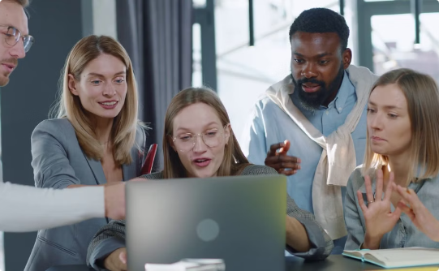
Importance of Phishing Awareness
Protecting Personal Data
Securing Business Operations
Building a Safer Online Environment
Phishing awareness helps individuals safeguard their personal information from theft and misuse.
Phishing attacks can disrupt business operations, compromise sensitive data, and cause financial losses.
By staying informed and vigilant, individuals contribute to a safer online environment for themselves and others.

Slide 10


Conclusion and Key Takeaways
Phishing is a prevalent online threat, but with a strong understanding of its tactics and protective measures, we can effectively safeguard ourselves and our data. Stay vigilant, report suspicious activity, and remember to be cautious when interacting with online communications.

